Slide 1

Program Analysis for Software Reliability and Security
Pranav Garg
University of Illinois at Urbana-Champaign
March 19, 2015

Slide 2
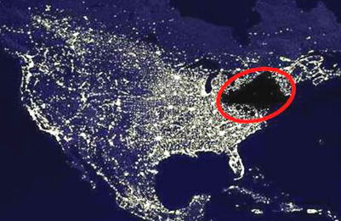


Bugs are bad. Bugs in critical software are worse!
2003 Power Outage
Loss > 6B USD
BMW security patch
> 2M vehicles
Heartbleed bug
> 0.5M websites
Software testing
Very good in finding bugs
Cannot prove the absence of bugs
(Later in the talk)
Verifying critical software
for provable security and reliability

Slide 3



Success stories in software verified for security and reliability
Compcert
secure L4 microkernel
integrity, confidentiality,
reliability
Compiler verified wrt
C semantics
ExpressOS @ UIUC
secure mobile OS
Hypervisor and Verve OS
isolation and type safety
integrity, isolation,
secure storage, UI isolation, …
Drawbacks: Huge manual effort is typically required
Goal of my research: Reduce manual effort significantly by automating key steps in verification

Slide 4
How does one verify software?
Inductive Invariant
Reach
Init
I
Bad
State space
Steps to verify software:
1. Specify an invariant.
2. Validate the invariant:
- includes Init
- excludes Bad
- is inductive
Main bottleneck to
automatic verification
Manual →
Simple properties → Automatic
Complex properties → Manual

Slide 5

Invariant Synthesis
Validating Invariants
CAV 14*
PLDI 13
Data-structures
Natural Proofs
SAS 13
CAV 13*
Sequential s/w
Machine learning
OOPSLA 14
TACAS 11
Concurrent, Distributed systems
Finite reductions
Concurrent s/w
Sequentializations
ICSE 13
ISCA 11
Memory errors/leaks
Automated Test generation
Transient faults
Application checkpointing
*Invited to journals FMSD and JACM

Slide 6
Outline
Invariant synthesis for verifying sequential software
Machine learning for synthesizing invariants
A new learning model ICE for invariant synthesis
Machine learning algorithms in the ICE model
Applications: ExpressOS, GPU Kernels, …
Software testing
Automated test generation for finding bugs

Slide 7
Software Verification 101
int i;
void increment(int n)
// Requires: (n >= 0);
{
i = 0;
while (i < n)
{
i = i + 1;
}
return;
}
// Ensures: i == n;
Step 1. Specify an invariant
// Loop invariant: i <= n
Step2. Validate the invariant:
Includes Init:
Excludes Bad:
Is inductive:

Slide 8
ExpressOS fragment: Cache of DiscPages
class CachePageHolder { // this.Head is a sorted list of CachePages
CachePage Head; // Class invariant: sorted(this.Head);
. . .
CachePage LookupPrev(int k) {
// Ensures: (ret != NULL => ret.Key <= k);
// Ensures: (ret != NULL && ret.Next != NULL) =>
ret.Next.Key > k;
CachePage current = Head, prev = null;
while (current != null && current.Key <= k) {
prev = current; current = current.Next;
} return prev;
}
. . .
}

Slide 9
ExpressOS fragment: Cache of DiscPages
class CachePageHolder { // this.Head is a sorted list of CachePages
CachePage Head; // Class invariant: sorted(this.Head);
. . .
CachePage LookupPrev(int k) {
// Ensures: (ret != NULL => ret.Key <= k);
// Ensures: (ret != NULL && ret.Next != NULL) =>
ret.Next.Key > k;
CachePage current = Head, prev = null;
while (current != null && current.Key <= k) {
prev = current; current = current.Next;
} return prev;
}
. . .
}

Slide 10
ExpressOS fragment: Cache of DiscPages
class CachePageHolder { // this.Head is a sorted list of CachePages
CachePage Head; // Class invariant: sorted(this.Head);
. . .
CachePage LookupPrev(int k) {
// Ensures: (ret != NULL => ret.Key <= k);
// Ensures: (ret != NULL && ret.Next != NULL) =>
ret.Next.Key > k;
CachePage current = Head, prev = null;
while (current != null && current.Key <= k) {
prev = current; current = current.Next;
} return prev;
}
. . .
}

Slide 11
ExpressOS fragment: Cache of DiscPages
class CachePageHolder { // this.Head is a sorted list of CachePages
CachePage Head; // Class invariant: sorted(this.Head);
. . .
CachePage LookupPrev(int k) {
// Ensures: (ret != NULL => ret.Key <= k);
// Ensures: (ret != NULL && ret.Next != NULL) =>
ret.Next.Key > k;
CachePage current = Head, prev = null;
while (current != null && current.Key <= k) {
prev = current; current = current.Next;
} return prev;
}
. . .
}
// Loop invariant:
sorted(this.Head) && ((prev == null && Head ->* current) ||
(Head ->* prev && current == prev.Next && prev.Key <= k));

Slide 12
Learning invariants: Solution 1
Not robust for
invariant generation
Invariant
Good
Bad
State space
Boolean classifier

Slide 13
Learning invariants: Solution 2
Labeled sample set
s₁: +
s₂: -
s₃: +
…
Verification Oracle
Program + Spec
Learner
Verifier
checks hypothesis
Invariant
Hypothesis H?

Slide 14
Counter-example: Positive
H
Good
Bad
New positive
counter-example

Slide 15
Counter-example: Negative
New negative
counter-example
Good
Bad
H

Slide 16
What happens if the invariant is not inductive?
H
Good
Bad
s₁
s₂
and
Don’t know whether these states should be included in the
invariant or not.
All we know:

Slide 17
ICE: Learning invariants using Implication Counter-Examples
([Garg et al. CAV 14], Invited to JACM)
ICE sample set
s₁ → s₂
s₃ → s₄
s₅ → s₆
s₇: +
s₈: -
s₉: +
…
Verification Oracle
Program + Spec
Learner
Verifier
checks hypothesis
Invariant
Hypothesis H?
New learning model for robust synthesis of invariants

Slide 18
Learning an invariant given an ICE sample
x₁ -10
x₁ – x₂ -2
Variable x₂
20
x₁ – x₂ -2
0
-20
-40
x₁
-10
-60
-40
-20
0
Variable x₁
Program State Space

Slide 19
Learning invariants using decision trees
Input space:
Class of Invariants: Arbitrary Boolean functions over linear
inequalities
where
is a pgm. variable
yes
no
yes
no
yes
no

Slide 20
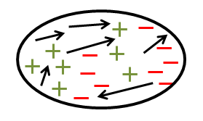
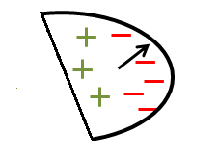
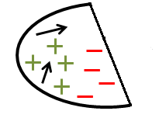
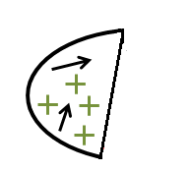
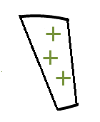
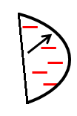

Learning decision trees given an ICE sample
Attribute
[Garg et al. 2015]
Entropy-based choice of
attributes in (+,-) case:
[Quinlan 1986]
Theorem [Garg et al. 2015]:
The above algorithm always produces a decision tree that
is consistent with the input ICE sample.

Slide 21
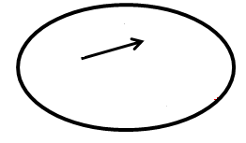
Choosing the best attribute
[Garg et al. 2015]
Measure 1: Extends Shannon entropy and Information Gain
to implications using probabilistic dependencies
is the root of
S₁
S₂
where: p, n, i is the number of positive points,
negative points and implications in S
Measure 2: Penalize implications “cut” by attribute

Slide 22
Some Invariants Learned
Benchmark programs:
from literature and software competitions
Are ~ 20-80 LOC
Invariants are involved:
Arbitrary Boolean
functions
Large constants

Slide 23
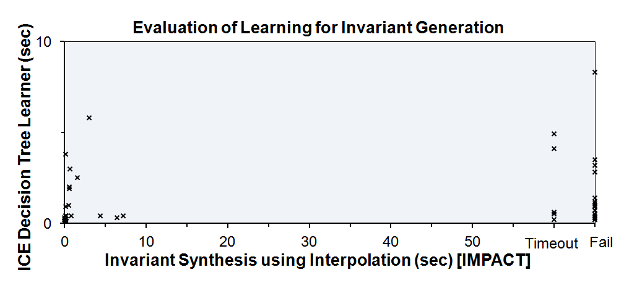
Results
Invariant Synthesis using Interpolation [IMPACT] | ICE Decision Tree Learner
Only 28/55 programs | All programs! < 10 seconds

Slide 24


GPUVerify
(ongoing work)
Verifies GPU kernels for data-race freedom
Converts the kernel to a non-deterministic sequential program
Synthesizes conjunctive invariant that imply race freedom
Decision tree learner gives 3x-5x speedup.
Scales to larger kernels.
Verify kernels that require disjunctive
invariants.
Race-freedom
Parallel GPU
kernels
Nondet.
Seq. programs
Assertions

Slide 25
ExpressOS fragment: Cache of DiscPages
class CachePageHolder { // this.Head is a sorted list of CachePages
CachePage Head; // Class invariant: sorted(this.Head);
. . .
CachePage LookupPrev(int k) {
// Ensures: (ret != NULL => ret.Key <= k);
// Ensures: (ret != NULL && ret.Next != NULL) =>
ret.Next.Key > k;
CachePage current = Head, prev = null;
while (current != null && current.Key <= k) {
prev = current; current = current.Next;
} return prev;
}
. . .
}
// Loop invariant:
sorted(this.Head) && ((prev == null && Head ->* current) ||
(Head ->* prev && current == prev.Next && prev.Key <= k));

Slide 26
Learning data-structure invariants ([Garg et al. CAV 13*, SAS 13, CAV 14], *Invited to FMSD)
Program configuration → explicit array and list contents
Properties are typically quantified.
Quantified Data Automata (QDA) for representing such
quantified formulas
Developed ICE learning algorithms for QDAs
Head
5
7
8
9
sorted
Head
y₁
y₂
y₁.Key <= y₂.Key

Slide 27
Results
Some Invariants Learned | Interpolation [ABGRS12] | ICE
 | <2s | <2s
 | Timeout | <2s
 | <2s | <2s
 | Timeout | <2s
 | Fail | 5s
 | Fail | <2s
 | Fail | <2s

Slide 28
System architecture
(LLVM)
Java
C/C++
C#
.NET
ICE sample
Boogie
Invariant generation
using ICE
(scalars, arrays, lists)
Z3 (SMT solver)
Invariant H?
Verification
Oracle
Learner

Slide 29
Outline
Invariant synthesis for verifying sequential software
Machine learning for synthesizing invariants
A new learning model ICE for invariant synthesis
Machine learning algorithms in the ICE model
Applications: ExpressOS, GPU Kernels, …
Software testing
Automated test generation for finding bugs

Slide 30
Automated Test generation
Software Under Test
Automatically generated tests
class Base {
Base();
Base *foo(int i);
...
}
class Derived : public Base {
Derived(int i);
void bar(Base *b);
...
}
...
int main()
{
Derived d0(1);
Base *b1 = d0.foo(0);
d0.bar(b1);
}
Generated tests useful for:
- increasing the coverage of manually generated tests
- finding bugs hidden in the implementation
Notes:
Idea is to automatically generate a test suite that tests the given software wrt certain properties: for eg., simplest property is if the program crashes or not, buffer overflows, memory safety, assertions in the program code are violated or not, etc.

Slide 31
Randoop: Feedback-directed random
testing
[Pacheco, Lahiri, Ernst, Ball @ ICSE 2007]
New target: Derived::foo(int)
Software Under Test
class Base {
Base();
Base *foo(int i);
...
}
class Derived : public Base {
Derived(int i);
void bar(Base *b);
...
}
...
Base *b1 = .foo( );
Good test drivers
Bad test drivers
(leading to crashes)
Base b0();
Derived d0(1);

Slide 32
Randoop: Feedback-directed random
testing
[Pacheco, Lahiri, Ernst, Ball @ ICSE 2007]
New target: Derived::foo(int)
Need value for int argument
Pick a random value
Software Under Test
class Base {
Base();
Base *foo(int i);
...
}
class Derived : public Base {
Derived(int i);
void bar(Base *b);
...
}
...
Base *b1 = .foo(1);
Good test drivers
Bad test drivers
(leading to crashes)
Base b0();
Derived d0(1);

Slide 33
Randoop: Feedback-directed random
testing
[Pacheco, Lahiri, Ernst, Ball @ ICSE 2007]
New target: Derived::foo(int)
Need value for int argument
Pick a random value
Need Derived object
Create new one
Pick from good test driver
Software Under Test
class Base {
Base();
Base *foo(int i);
...
}
class Derived : public Base {
Derived(int i);
void bar(Base *b);
...
}
...
Derived d0(1);
Base *b1 = d0.foo(1);
Compile and run the new test
Test fails
Good test drivers
Bad test drivers
(leading to crashes)
Base b0();
Derived d0(1);
Derived d0(1);
Base *b1 = d0.foo(0);

Slide 34
Randoop: Feedback-directed random
testing
[Pacheco, Lahiri, Ernst, Ball @ ICSE 2007]
New target: Derived::foo(int)
Need value for int argument
Pick a random value
Need Derived object
Create new one
Pick from good test driver
Software Under Test
class Base {
Base();
Base *foo(int i);
...
}
class Derived : public Base {
Derived(int i);
void bar(Base *b);
...
}
...
Derived d0(1);
Base *b1 = d0.foo(1);
Compile and run the new test
No Failure
Good test drivers
Bad test drivers
(leading to crashes)
Base b0();
Derived d0(1);
Derived d0(1);
Base *b1 = d0.foo(0);

Slide 35
Randoop: Feedback-directed random
testing
[Pacheco, Lahiri, Ernst, Ball @ ICSE 2007]
Software Under Test
Next target: Derived::bar(Base*)
class Base {
Base();
Base *foo(int i);
...
}
class Derived : public Base {
Derived(int i);
void bar(Base *b);
...
}
...
Derived d0(1);
Base *b1 = d0.foo(0);
d0.bar(b1);
No Failure
. . .
Good test drivers
Bad test drivers
(leading to crashes)
Base b0();
Derived d0(1);
Derived d0(1);
Base *b1 = d0.foo(0);

Slide 36
Randoop: coverage plateaus out
Software Under Test
class Base {
Base *foo(int i)
{
if (i >= 0) {
...
} else {
target branch:
}
...
}
...
}
...
Test driver
Derived d0(1);
Base *b1 = d0.foo(1);
Coverage
Time
Hard to cover deep branches and complex object interactions
Integrate Randoop with Symbolic execution!
Notes:
Randoop is automatic; requires no user input

Slide 37
Introduction to symbolic execution
Execute program with symbolic values for input variables
For a program path, collect symbolic path constraints
Use decision procedure/theorem prover to check satisfiability
Can generate hard-to-find inputs for corner cases
Issues in practice with symbolic execution
Path explosion (slow starter wrt. random testing)
Handling complex expressions precisely (eg., heap,
non-linear computations, …)
Scalability and imprecision of symbolic execution
long paths create large constraint problems
constraints along long paths are prone to be imprecise

Slide 38
Directed random + symbolic execution
[ICSE 2013]
Combine directed random test generation with symbolic execution
Strategy:
Use symbolic execution once random
test generation saturates.
Use test drivers generated by symbolic
execution to further seed random test
generation.
Works very well
Fully automated unit test generation
Over 70% branch and statement
coverage within a few minutes of
test generation
Program under analysis
Test generator selection
Directed random test driver generation
Symbolic execution based test generation
Drivers uncovering hidden bugs
Drivers violating implicit contracts
Drivers with normal runtime execution

Slide 39
Overcoming practical challenges in
symbolic execution
Path explosion problem
Start with random test generation.
Use symbolic execution once the coverage plateaus out.
Scalability issues and imprecision along long paths
Use BFS (instead of DFS) strategy for generating new tests → involves smaller path prefixes
Handling complex expressions (non-linear code) precisely
Integrate solvers that handle non-linear expressions
Used when constraints are imprecise due to non-linear code
More efficient than always using non-linear solvers
Imprecision detected using a light-weight static analysis

Slide 40
Experimental setup
Benchmark | Language | #LOC | #Functions | #Branches
tree | C | 1.6K | 18 | 48
list | C++ | 1.5K | 10 | 40
queue | C++ | 2.9K | 18 | 102
coldet | C++ | 10.7K | 118 | 834
gnuchess-1 | C | 29.3K | 316 | 2195
gnuchess-2 | C | 40.2K | 272 | 3026
ddrescue | C++ | 19.0K | 151 | 1336
tinyxml | C++ | 13.4K | 284 | 1215

Slide 41
Results: branch coverage
Benchmark | Branch Coverage (%)
 | Randoop | Symbolic Execution | Randoop + Symbolic execution [ICSE’13]
tree | 92 | 90 | 92
list | 43 | 43 | 43
queue | 65 | 67 | 69
coldet | 41 | 28 | 75
gnuchess-1 | 28 | 25 | 31
gnuchess-2 | 14 | 11 | 30
ddrescue | 21 | 22 | 37
tinyxml | 43 | 43 | 44

Slide 42

Results: analysis of crashed test drivers
Manual inspection of crashed drivers revealed:
many bugs in the open source projects
NULL pointer accesses, infinite loops,
buffer overflows and underflows, stack overflows,
division by zero, double free, …
violations of implicit method invocation protocols in the test drivers
parameters to called functions in the drivers are not
well correlated
Remember !!!

Slide 43
Additional challenges
Strengthen test oracles or properties
to catch more bugs
- memory safety, buffer overflows, …
- Use test runs to learn invariants; violations might indicate bugs?
Better utilization of the object pool
- Utilize manually written tests
Automatically discern bugs from
violations of implicit protocols/preconditions
- Learn preconditions and method
invocation protocols from tests
Program under analysis
Test generator selection
Directed random test driver generation
Symbolic execution based test generation
Drivers uncovering hidden bugs
Drivers violating implicit contracts
Drivers with normal runtime execution
Thank you!

